Slide 1
Carbohydrates & Fermentation Industries

Slide 2
Carbohydrates
Naturally occurring combinations of C, H and O
With H and O in 2:1 ratio (Hydrates of Carbon)
The most common types
Sucrose (ordinary sugar)
Starch
Dextrose
Cellulose
Fermentation Industries
Use carbohydrates as a substrate for production of various chemicals & biologicals.

Slide 3
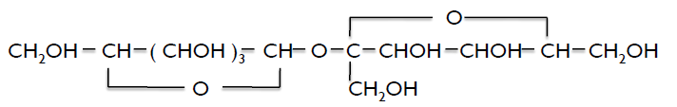
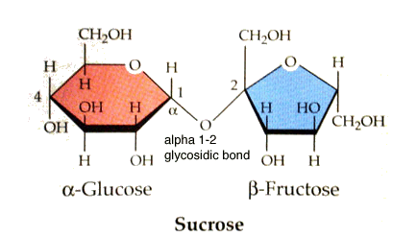
Sucrose
Chemical formula : C₁₂H₂₂O₁₁ (disaccharide)
Naturally in most fruits and vegetables. Sugar occurs in greatest quantities in sugarcane and sugar beets from which sugar is separated economically and commercially.
Structural formula : (Glucose + Fructose)
Molecular weight – 342
Density = 1.58 kg/m³
Sucrose is soluble in water but
slightly soluble in methyl alcohol
and ethyl alcohol.

Slide 4
Production Process
India is the homeland of sugarcane and sugar.
Process : Extraction of sugarcane
Crystalline white sugar
Gur, a dark brown sugar concentrate
Raw Material : Sugarcane
composition of sugarcane juice differences between varieties and location. It is a solution, containing soluble and insoluble impurities (i.e non sucrose species).
It’s is also slightly acid with the pH between 4.5- 5.5, TSS 15-25 and sucrose 10 – 20 % w/w.

Slide 5
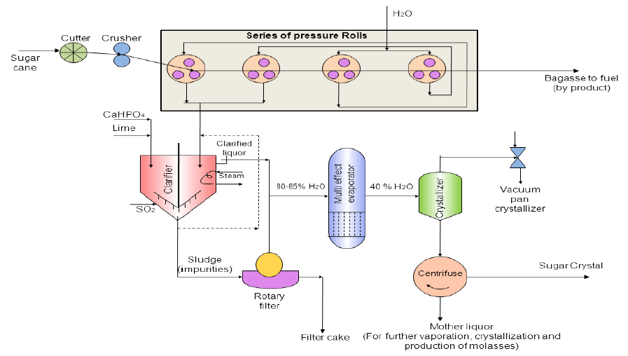
Process Flowsheet
Activate
Carbon Filter
Juice extraction pressing →Purification of juice →Clarification → evaporation → Crystallization → Centrifugation → Drying and screening

Slide 6
Process Description
Juice extraction pressing
Two or three heavily grooved crusher rollers break the cane and extract a large part of the juice. Revolving knives cutting the stalks into chips are supplementary to the crushers.
As the cane is crushed, hot water (or a combination of hot water and recovered impure juice) is sprayed onto the crushed cane counter currently.
Clarification
The juice from the mills, a dark green color, is acid and turbid.
The clarification (or defecation) process is designed to remove both soluble and insoluble impurities (such as sand, soil, and ground rock)
The process employs lime and heat as the clarifying agents. Milk of lime neutralizes the natural acidity of the juice, forming insoluble lime salts.
Heating the lime juice to boiling coagulates the albumin and some of the fats, waxes, and gums, and the precipitate formed entraps suspended solids as well as the minute particles.
The muds separate from the clear juice through sedimentation. The non-sugar impurities are removed by continuous filtration. The final clarified juice contains about 85 percent water and has the same composition as the raw extracted juice except for the removed impurities.

Slide 7
Evaporation
To concentrate this clarified juice, about two-thirds of the water is removed through vacuum evaporation.
Generally, four vacuum-boiling cells or bodies are arranged in series so that each succeeding body has a higher vacuum (and therefore boils at a lower temperature). The vapors from one body can thus boil the juice in the next one—the steam introduced into the first cell does what is called multiple-effect evaporation. The vapor from the last cell goes to a condenser. The syrup leaves the last body continuously with about 65 percent solids and 35 percent water.
Crystallization
Crystallization is the next step that takes place in a single-stage vacuum pan. The syrup is evaporated until saturated with sugar. As soon as the saturation point has been exceeded, small grains of sugar are added to the pan. These small grains, called seed, serve as nuclei for the formation of sugar crystals. Additional syrup is added and evaporated so that the original crystals that were formed are allowed to grow in size.
The growth of the crystals continues until the pan is full. When sucrose concentration reaches the desired level, the dense mixture of syrup and sugar crystals, called massecuite, is discharged into large containers known as crystallizers. Crystallization continues in the crystallizers as the massecuite is slowly stirred and cooled.

Slide 8
Centrifugation
Massecuite from the mixers is allowed to flow into centrifugals, where the thick syrup, or molasses, is separated from the raw sugar by centrifugal force.
The high-speed centrifugal action used to separate the massecuite into raw sugar crystals and molasses. A centrifugal machine has a cylindrical basket suspended on a spindle, with perforated sides lined with wire cloth, inside which are metal sheets containing 400 to 600 perforations per square inch.
The basket revolves at speeds from 1,000 to 1,800 RPM. The raw sugar is retained in the centrifuge basket because the perforated lining retains the sugar crystals. The mother liquor, or molasses, passes through the lining (due to the centrifugal force exerted). The final molasses (blackstrap molasses) containing sucrose, reducing sugars, organic non-sugars, ash, and water, is sent to large storage tanks.
Drying and packaging
Damp sugar crystals are dried by being tumbled through heated air in a granulator. The dry sugar crystals are then sorted by size through vibrating screens and placed into storage bins. Sugar is then sent to be packed in the familiar packaging we see in grocery stores, in bulk packaging, or in liquid form for industrial use.

Slide 9
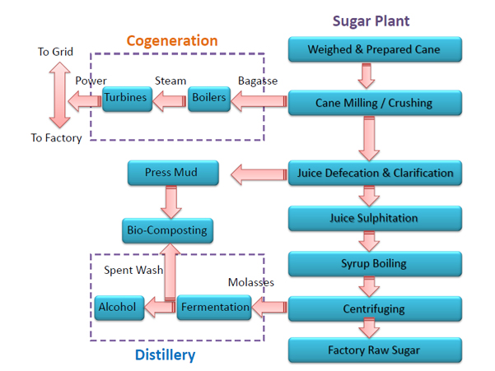
Plant Economy

Slide 10
Major engineering problems
Extraction of juice from cane
Optimization : design of rolls, temperature, time of operation
Use of ultrasonic vibration
Choice of flocculation agents
High magnesia lime is old but best choice
CO₂ in carbonation step : reduce alkalinity ; improved filterability and decolorization
Evaporation & Crystallization
Difficult crystallization, Calendria type evaporators are used
Crystallization : batch-wise in 4th or last effect
Measurement of supersaturation : boiling point rise, vacuum measurement and control

Slide 11
Critical zone of supersaturation
Transition region- pulverized sugar seeds are added and new nuclei are produced at highest point of saturation (graining)
Metastable region- degree of supersaturation is reduced by decreasing vacuum and crystal will grow
Simultaneous feed liquor addition and evaporation can raise the total quantity of crystal.
Separation of crystal from syrup
Improved centrifugal machine design (high speed 1800-2400 rpm)
Control of viscosity and surface tension of syrup give clean and rapid separation

Slide 12
Inversion of sugar
Acid hydrolysis of sugar in glucose and fructose
The extent of inversion is measured by polarimeter. The non inverted sugar has +97° polarization and completely inverted sugar has -20° polarization.
Minimized by : making quick delivery to the sugarcane presses less than 2 days
Low temperature – short time conditions : to reduce inversion

Slide 13
Extraction from sugarcane for Gur production
Low cost product made by simple evaporation process.
Cane juice extraction → Clarification
Concentration
Occurs in open pan evaporators until (80-85% solidification).
The product run out of the bottom of pan.
The product is dark brown solidifies paste at room temperature and invert partially to mono-saccarides on storage.
It contains neutritionally desirable minerals, particularly iron.

Slide 14
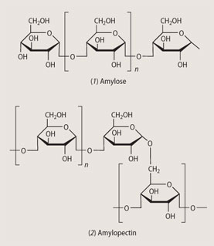
Starch
High polymer carbohydrate
Occur in grains and roots in form of granules (3-100 µ)
Chemical formula : C₆H₁₀O₅
n varies 200-500
Major source : Maize kernel
n

Slide 15
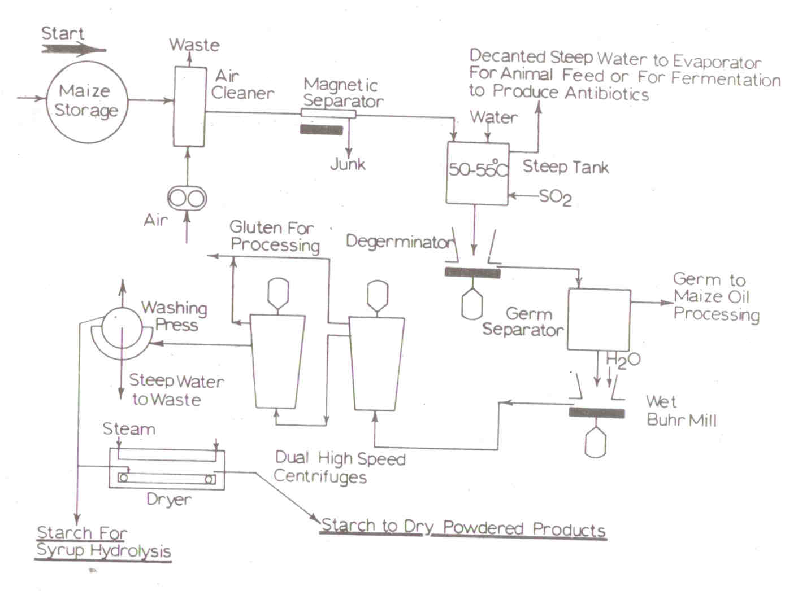
Process Description
Cleaning & screening
Steeping
Coarse grinding & degermination
Fine grinding & extraction
Gluten separation
Starch refining
Dehydration & drying

Slide 16
Manufacture of Ethanol from Molasses
Ethanol is a volatile, flammable, clear, colorless liquid.
A good solvent. It is also used as a germicide, beverage, antifreeze, fuel, depressant and chemical intermediate.
Molecular formula- C₂H₅OH
Molecular weight- 46.07
Density- 0.791 at 20˚C
Boiling Point- 78.3˚C
It can be made by the fermentation process of material that contains sugar or from the compound which can be converted to sugar.

Slide 17
Methods of Production
Fermentation
From sucrose substrate
Yeast enzyme readily ferment sucrose to ethanol.
From waste sulfite substrate of paper mills
From starch substrate
Petroleum Processing
Catalytic hydration of ethylene
Esterification and hydrolysis of ethylene
Oxidation of petroleum

Slide 18
Fermentation
Fermentation applies to both the aerobic and anaerobic metabolic activities of micro-organisms in which specific chemical changes are brought about in an organic substrate due to the enzymes produced by those microbes.
Fermentation is the core part of distillery which is carried out in large cylindrical vessel generally made of stainless steel is called as fermenter.
The media which has been prepared is introduced in the prefermenter and after 7 - 8 hours it is transferred into fermenter where fermentation is carried out.
Here batch fermentation is carried out without maintenance of complete sterility of equipment. However, this pre supposes a rapid start of the yeast fermentation. This fermentation inhibits the growth of other microbes by depleting the available nutrients, by lowering the pH and most importantly by the formation of ethanol. To reduce the pH H₂SO₄ is usually added.
As we know molasses contain approximately 50% invert sugar i.e. sucrose. It is converted into glucose and fructose in the presence of yeast and invertase enzyme.

Slide 19
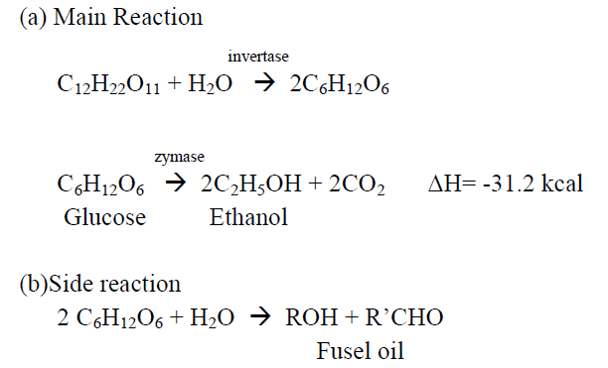
Ethyl alcohol by fermentation
Enzymatic reactions
Enzymes (bio-catalyst)are produced by living organism (bacteria)
Mild Condition : pH 4 -9 and T 30 to 70 ˚C.
Raw material requirements: Molasses (50-55% total sugar); Sulfuric acid; Ammonium sulfate.

Slide 20
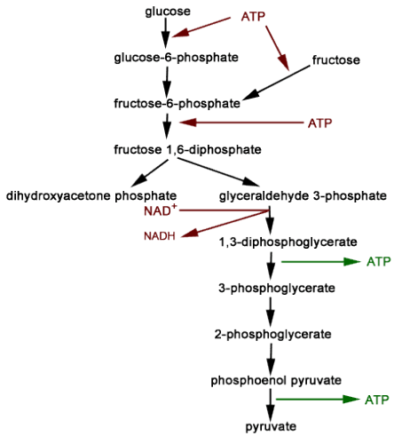
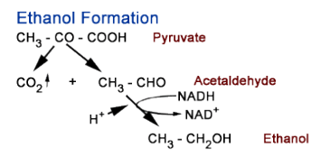

Slide 21
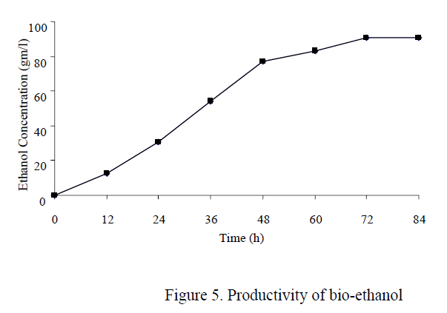
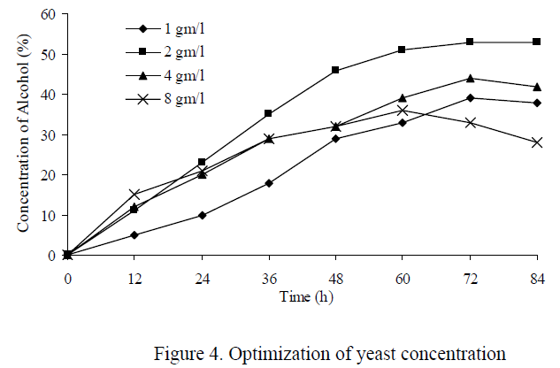
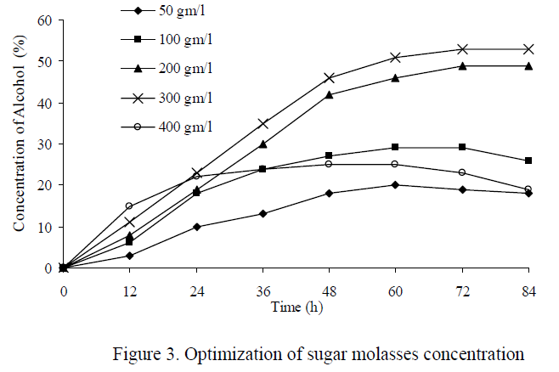
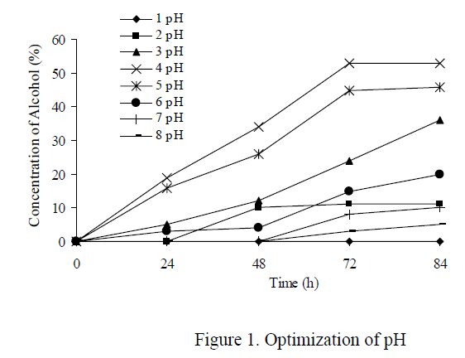
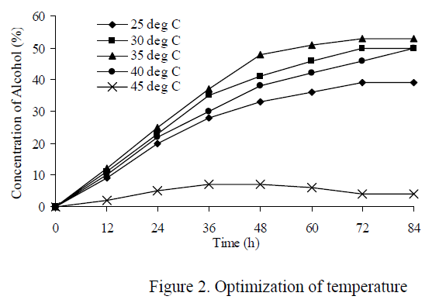
Effect of various factors on ethanol conversion

Slide 23
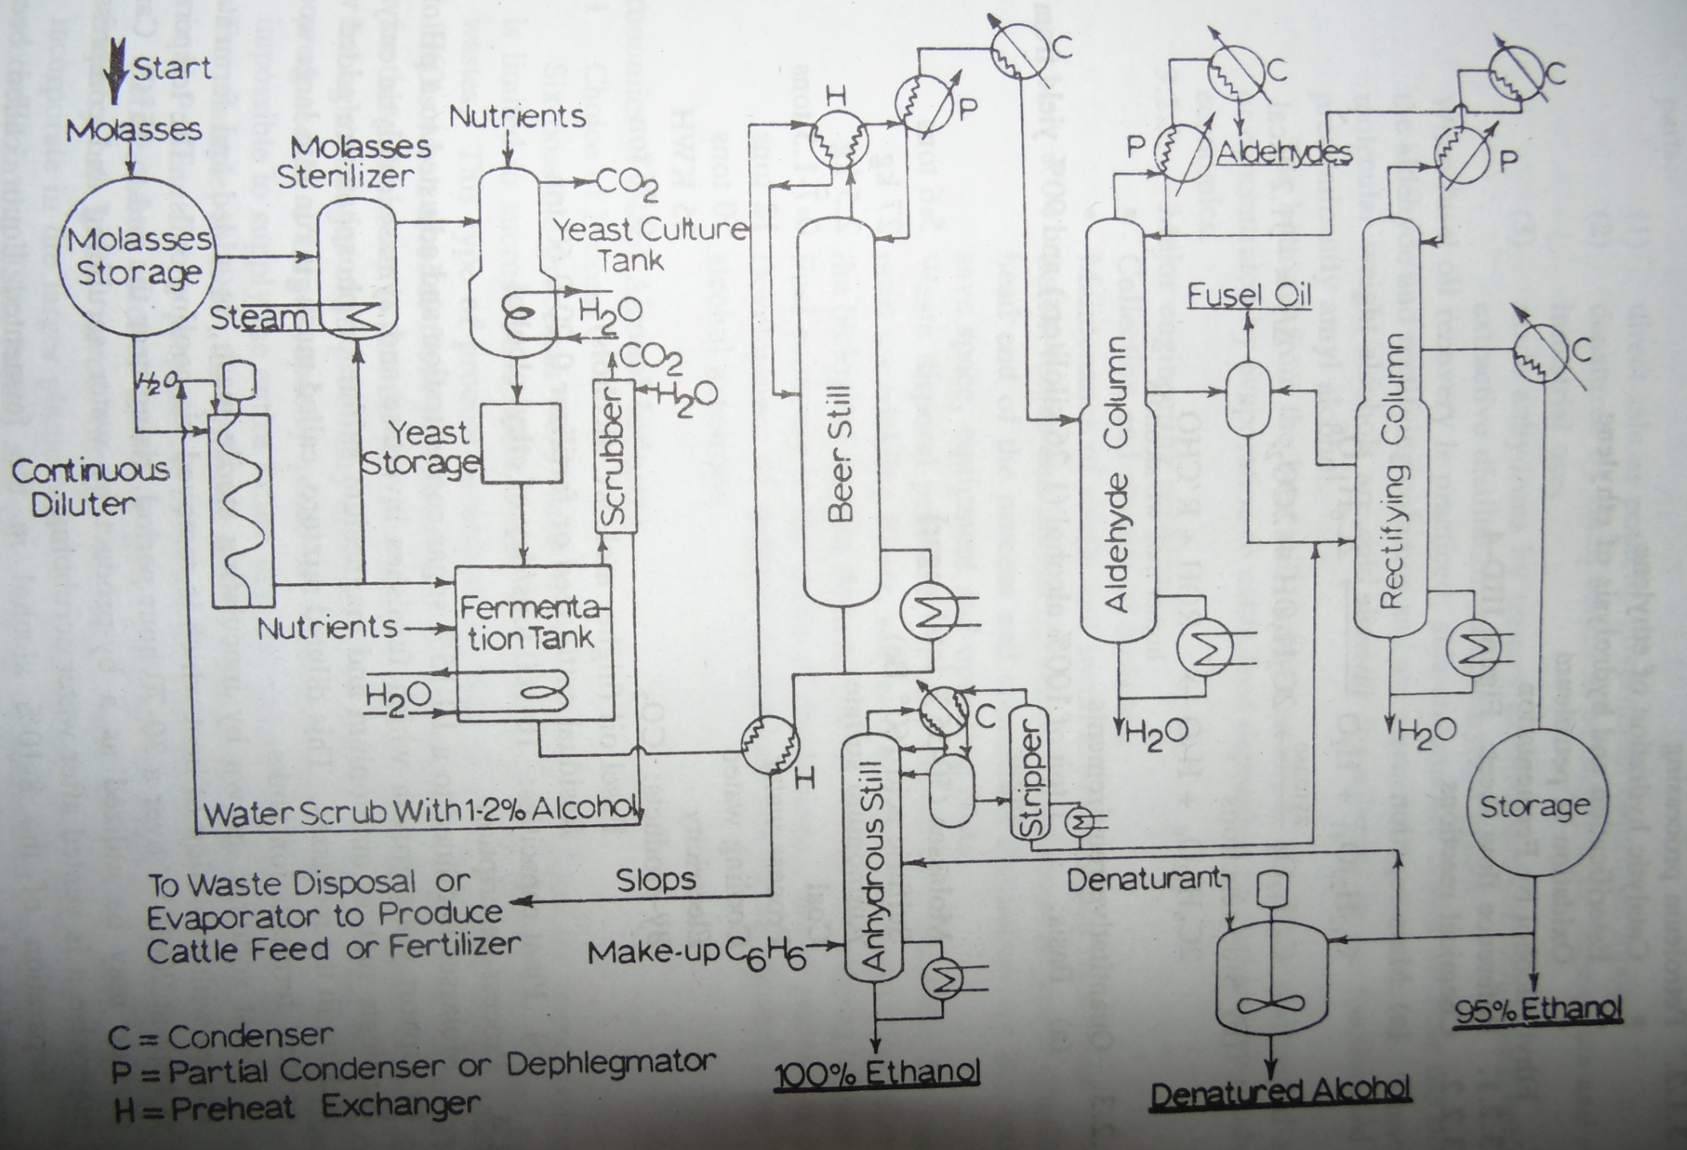
Process Description

Slide 24
Functional role of various units
Molasses storage tank: Molasses (liquor obtained as by product of sugar industries) is a heavy viscous material, which contains sucrose, fructose and glucose (invert sugar) at a concentration of 50-60(wt%).
Sterlization tank: Yeast is sterilized under pressure and then cooled.
Yeast cultivation tank: Yeast grows in the presence of oxygen by budding. Yeast is cultivated in advance.
Yeast storage tank: Yeast are unicellular, oval and 0.004 to 0.010mm in diameter. PH is adjusted to 4.8 to 5 and temperature up to 32˚C.
Fermentation tank: Chemical changes are brought by the action of enzymes invertase and zymase secreted by yeast in molasses. Fermentation is anaerobic. Heat is evolved which is removed by cooling coils. Residence time is 30-70 hours and temperature is maintained at 20-30˚C. 8 -10%alcohol by volume(beer) is produced by fermentation process. HCl or sulfuric acid is added to obtain pH 4.5

Slide 25
(f)Diluter: Here molasses is diluted to 10 to 15% sugar solution.
(g)Scrubber: Carbondioxide is released and utilized as by product. By-product CO₂ contains some ethanol due to Vapor liquid evaporation and can be recovered by water scrubbing. Water is sent back to continuous diluter stream.
(h)Beer still: 50-60% concentration alcohol and aldehyde is produced. Slops are removed as bottom product. Slop is concentrated by evaporation for cattle feed or discharged as waste. Slop contains proteins, sugar and vitamins.
(i)Aldehyde still: Undesirable volatile liquid; aldehyde is taken off from the top of the still. From the side stream alcohol is feed to the decanter.
(j)Decanter : Fusel oil which is high molecular weight alcohol is recovered by decantation. The principle behind extraction of fusel oil from ethanol is that higher alcohols are more volatile than ethanol in solution containing a high concentration of water.
(k)Rectifying column: In the column, azeotropic alcohol- water mixture of 95% ethanol is withdrawn as side product. This 95% ethanol is condensed in condenser and stored in storage tank. Side stream is withdrawn and sent to decanter. At the bottom, water is discharged. Here, alcohol – water mixtures are rectified to increase the strength of alcohol.

Slide 26
(l)Storage tank: From storage tank, three streams are evolved:
Direct sale as potable alcohol
Denatured by small addition of mildly toxic agent for industrial use.
To anhydrous still to produce 100% ethanol.
(m)Mix tank: For producing denatured alcohol, denaturant is mixed with the 95% ethanol produced from rectifying column. Denaturant is normally methanol/naphtha (10vol%)
(n)Ternary Azeotropic distillation: The product from rectifying column is a ternary minimum boiling azeotrope of ethanol, water and benzene. Benzene is an azeotropic agent.
Main units present are: anhydrous still, decanter, stripper and few heat exchangers.
Anhydrous motor fuel grade ethanol (100% ethanol) is produced as product.
Heat integration and energy recovery plays a vital role in reducing energy requirements.

Slide 27
Engineering Problems
Collection and storage of molasses
Maintenance of sterile and specific yeast culture conditions.
Batch versus continuation operation
Waste disposal problem
Development of methods to produce anhydrous alcohol from the 95% alcohol azeotrope

Slide 28
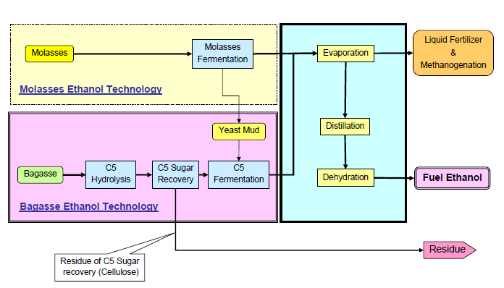
Second generation ethanol production technology

Slide 29
